Slide 1


MUSIC WEBSITE
DEPARTMENT OF COMPUTER SCIENCE & TECHNOLOGY
By: Hardik Arora
2K19CSUN03008
BTECH-CSE-DTE
SEM-4th

Slide 2
The main objective of the Music Website is to create a website for a music app named “Lynx” so that it serves all purposes of listening, downloading getting support etc.
Objective
Open app.js and run npm app.js in terminal using vscode or PowerShell.
Enter localhost/3000 in browser’s address bar to start the website.

Slide 3
Software Requirements
For running the project, PHP and connecting database XAMPP has been used.
Number | Description | Type
1 | Operating System | Windows
2 | Language | HTML ,JS, CSS, Node JS
4 | IDE | Visual Studio Code
5 | Browser | Google Chrome or any other

Slide 4
Functionalities Provided:
Frontend consist of hyperlinks to premium, support ,download ,signup ,and login page.
Premium and support pages
are still under construction
but shows registration link for premium account.
Website is fully responsive and provides hamburger menu for mobile navigation.
Login page allows taking user details and supports light and dark theme.
We can choose light and dark theme in index page by clicking on “Lynx”.
Download and signup pages are also under construction, on opening they show a music video running in background with available soon message.

Slide 5
Technologies used:
For Frontend
HTML5
For Login Page
CSS3
JS
HTML5
CSS3
JS
Node JS/ Express

Slide 6
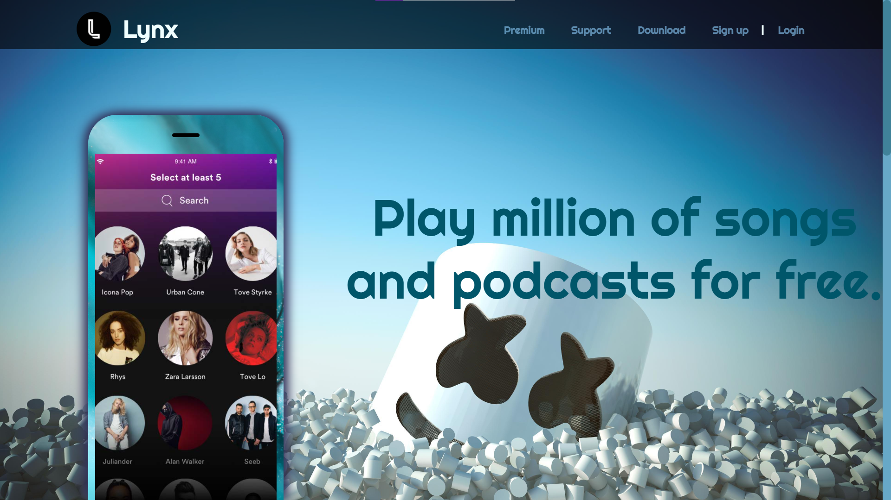
Index page light theme:

Slide 7
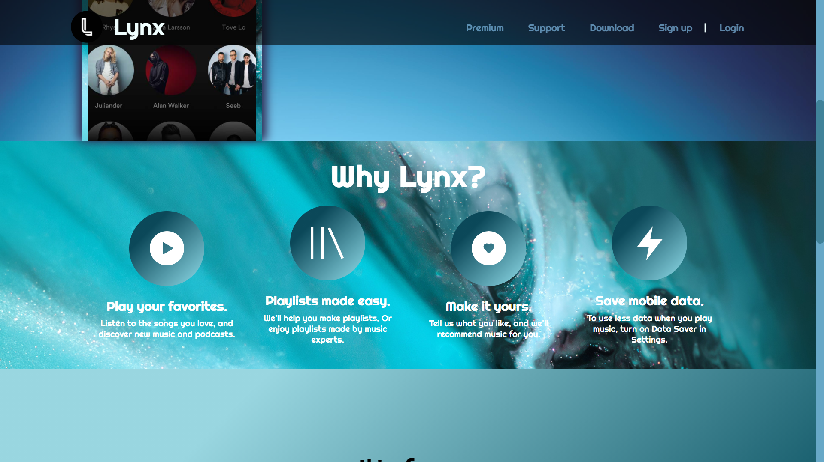
Index page light theme:

Slide 8
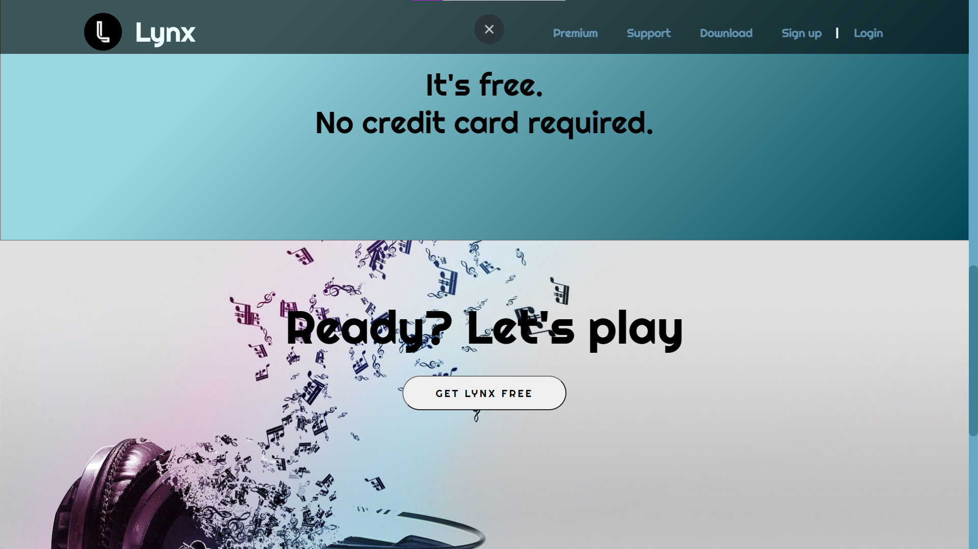
Index page light theme:

Slide 9
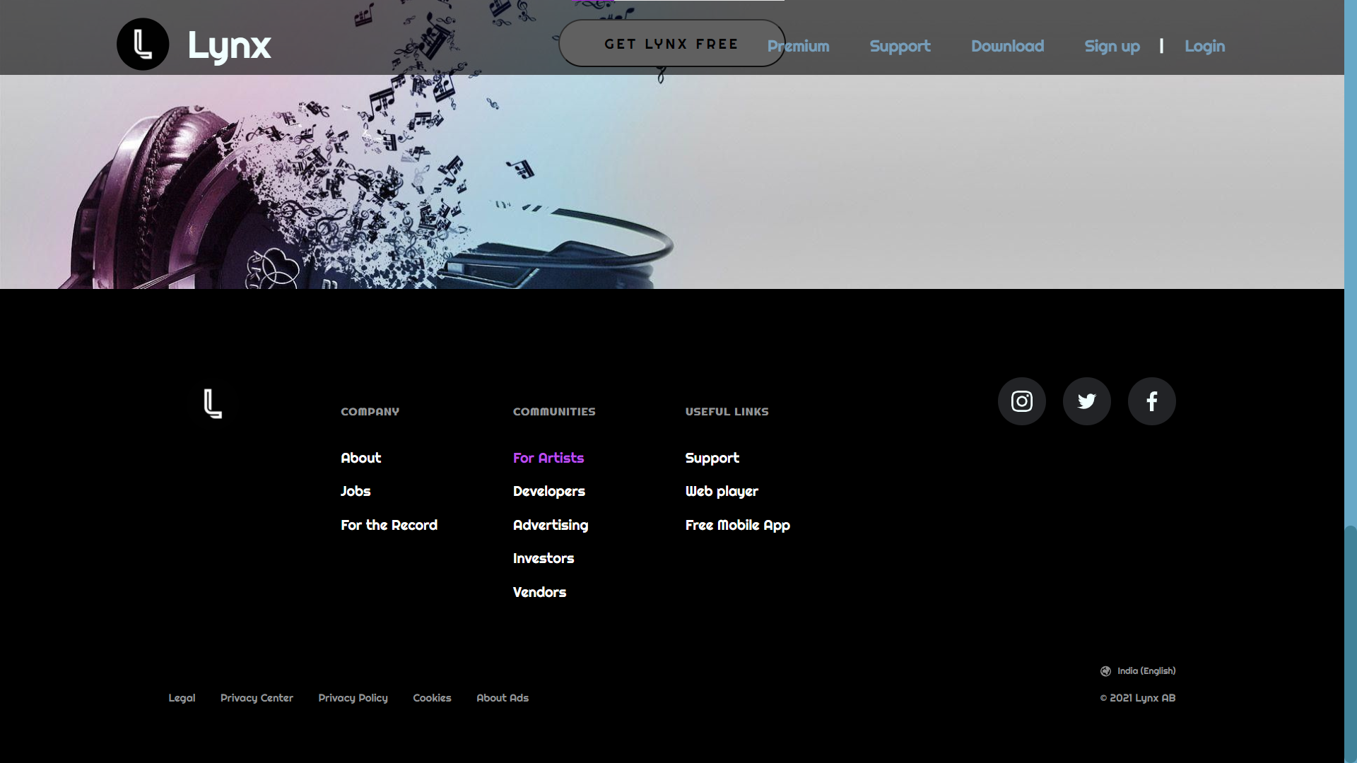
Index page light theme:

Slide 10
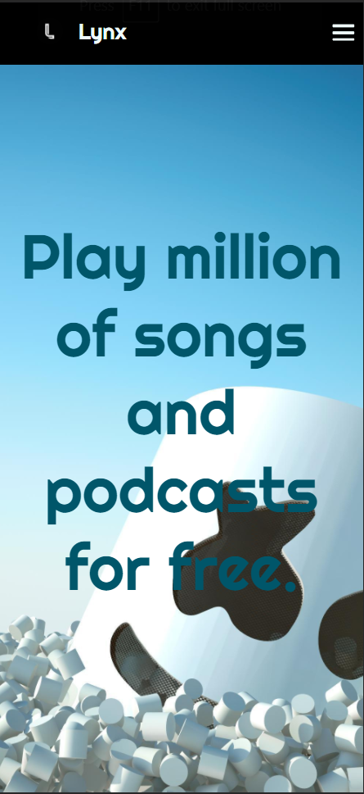
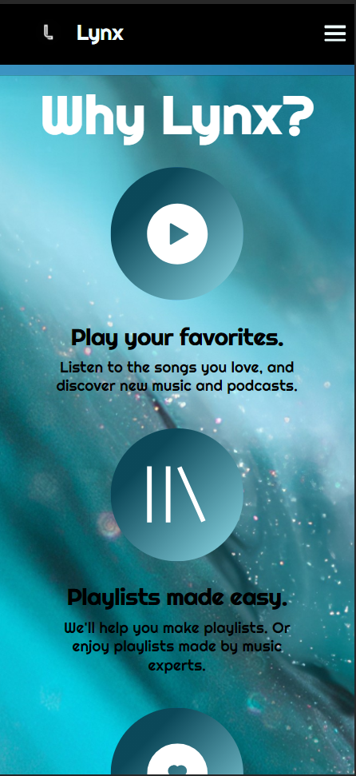
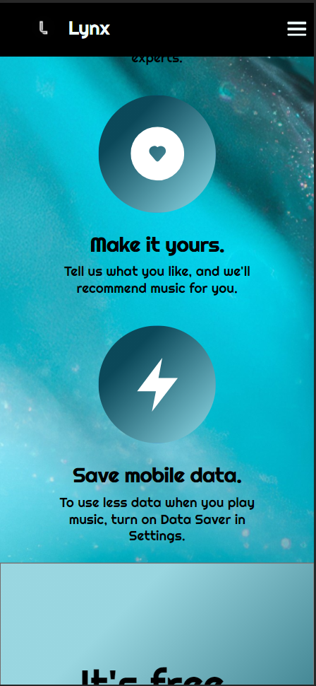
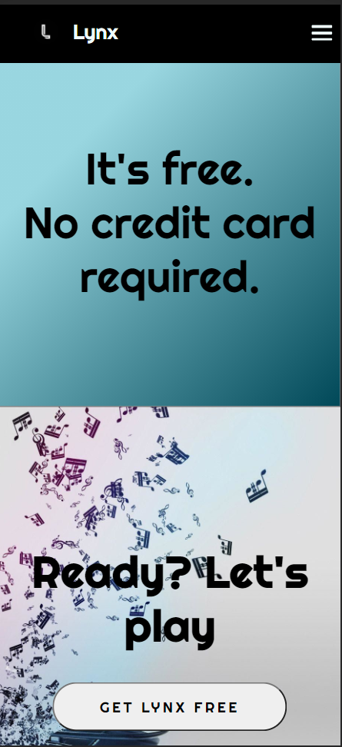
Index page light theme responsive:

Slide 11
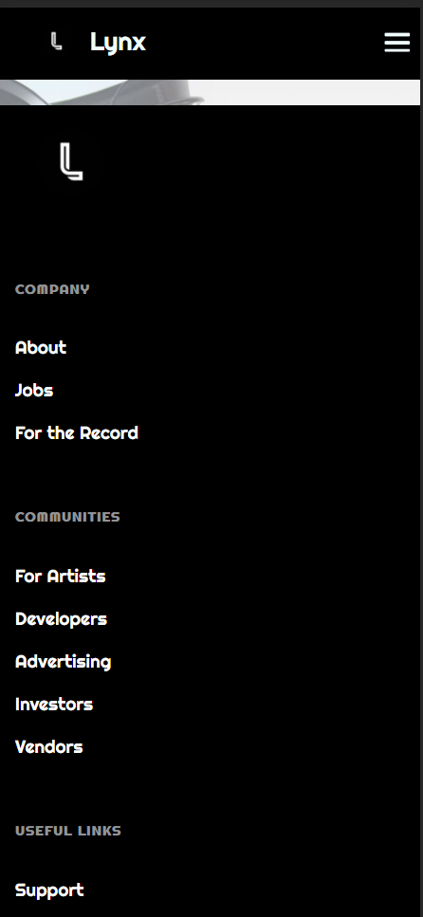
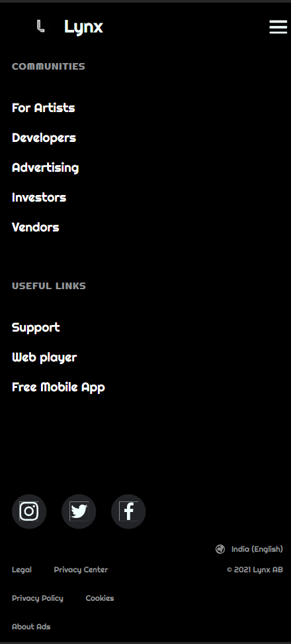
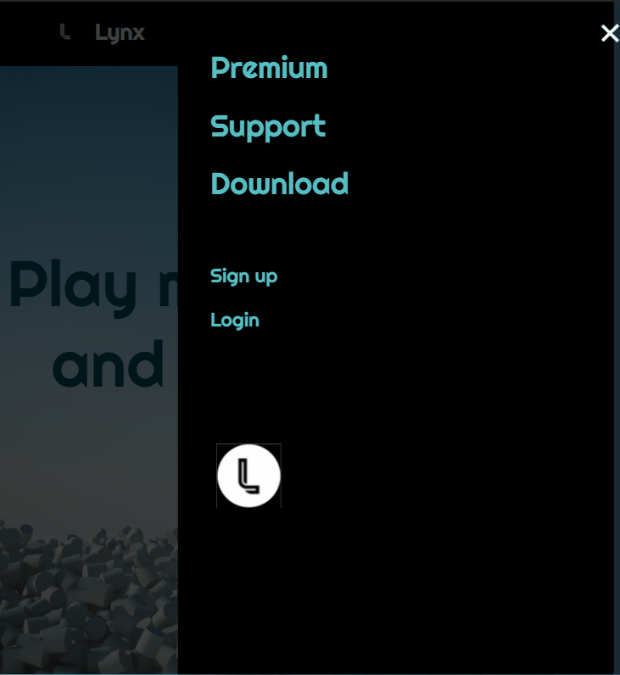
Index page light theme responsive:

Slide 12
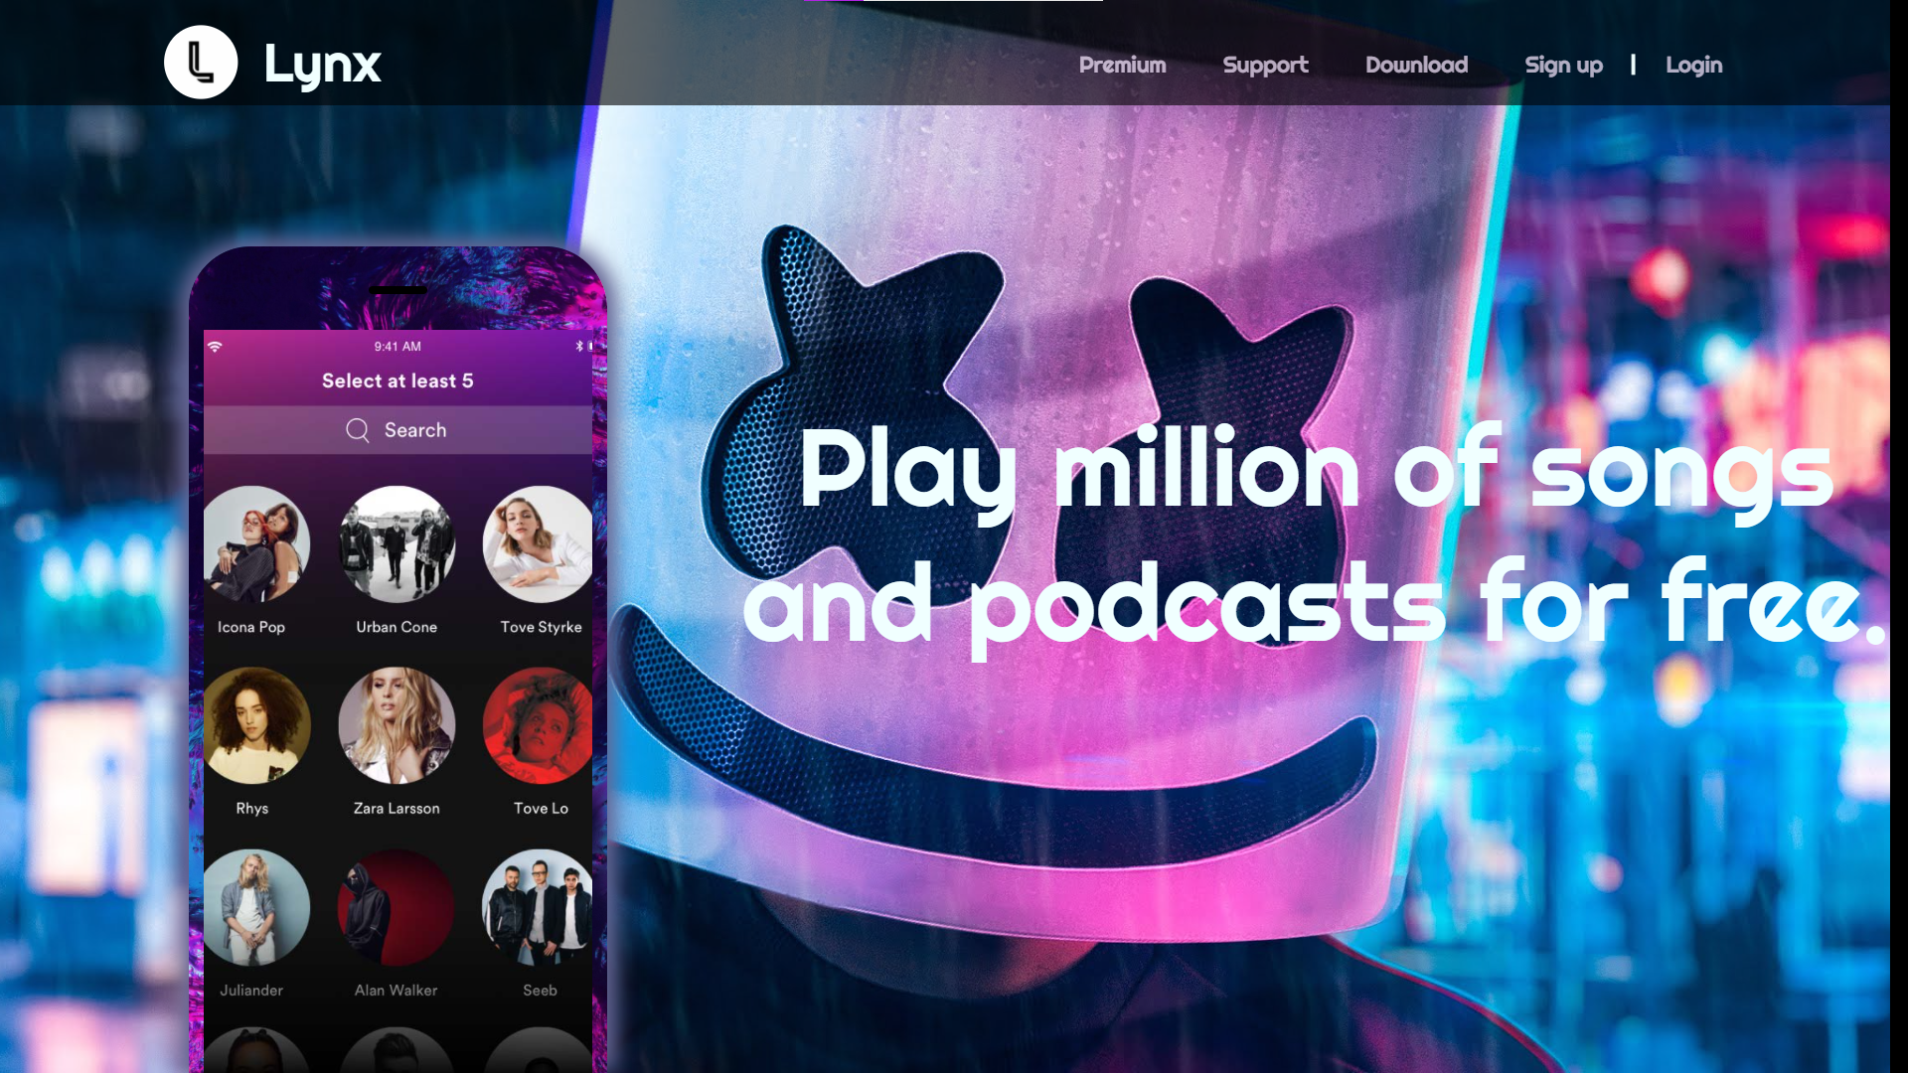
Index page dark theme:

Slide 13
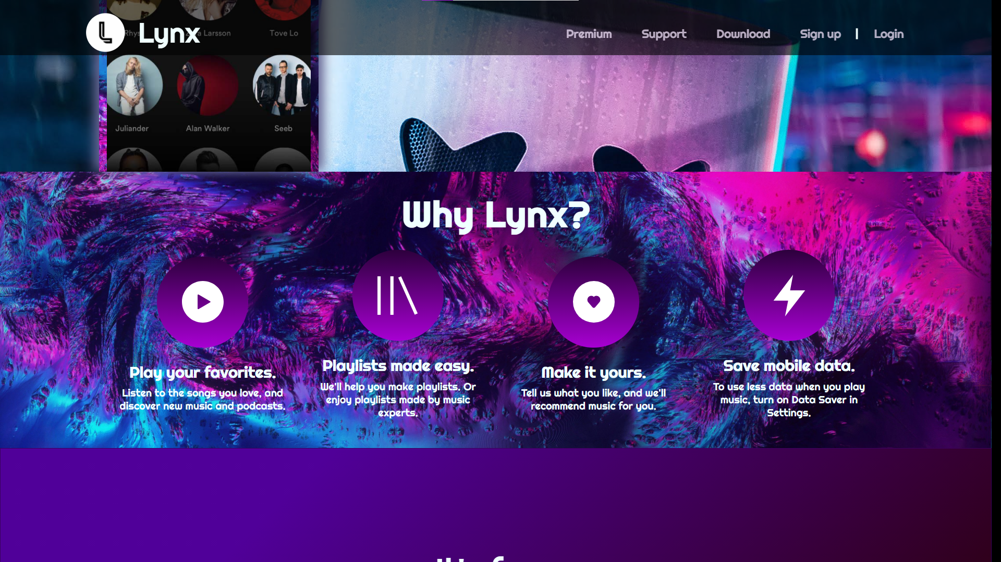
Index page dark theme:

Slide 14
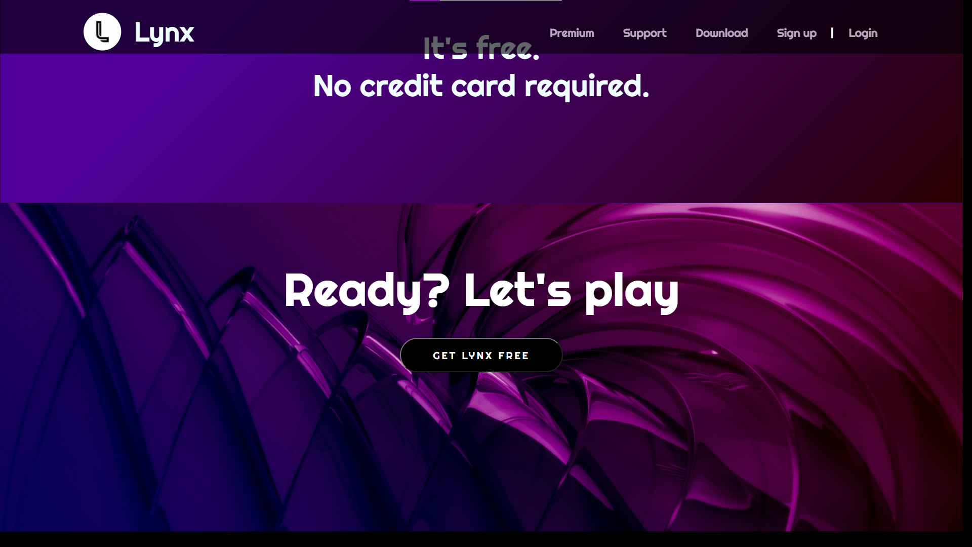
Index page dark theme:

Slide 15
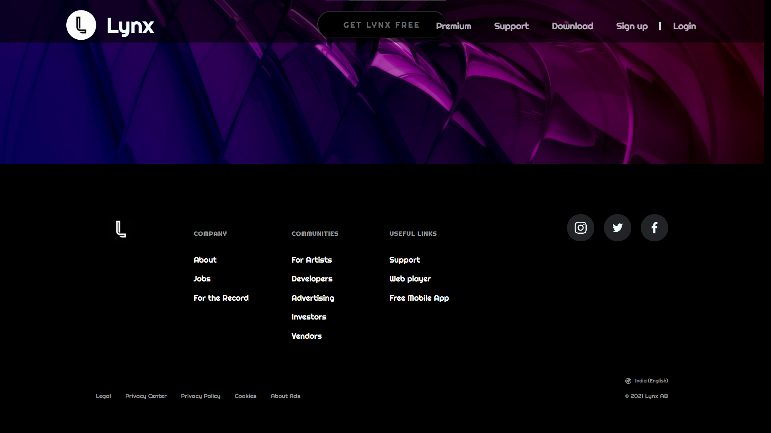
Index page dark theme:

Slide 16
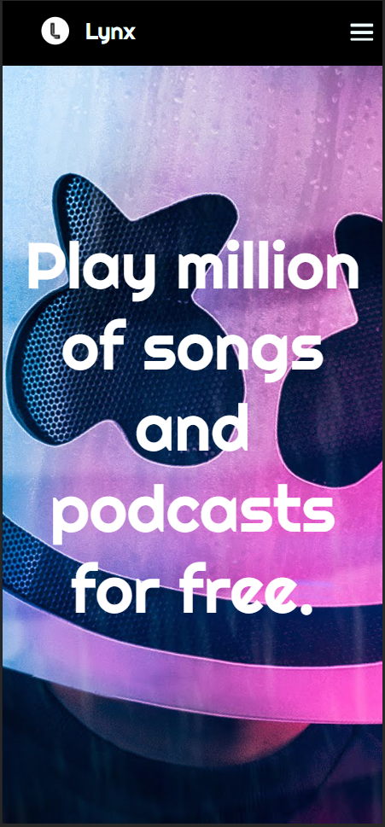
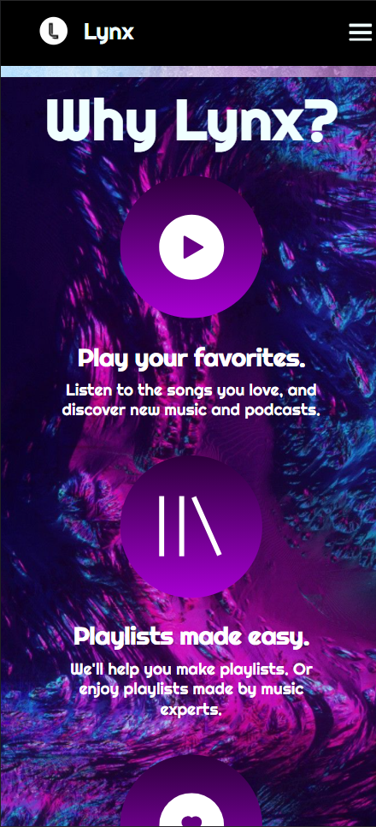
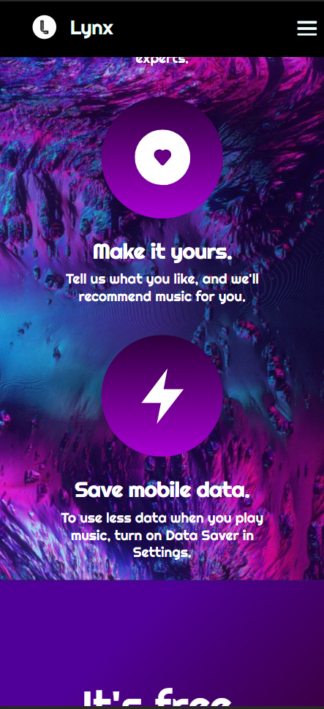
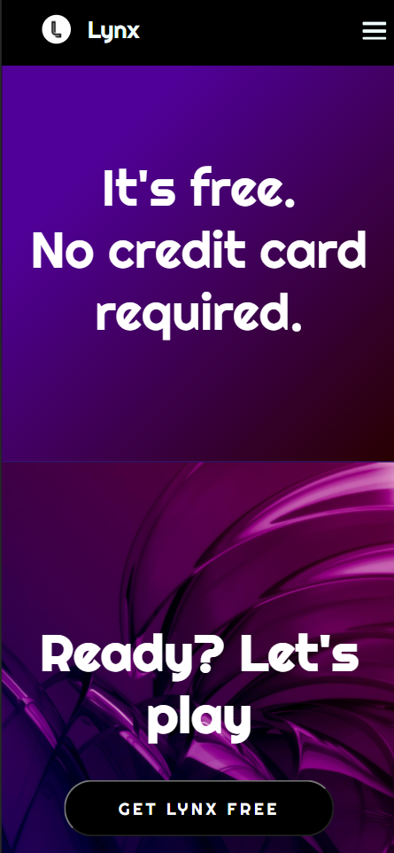
Index page dark theme responsive:

Slide 17
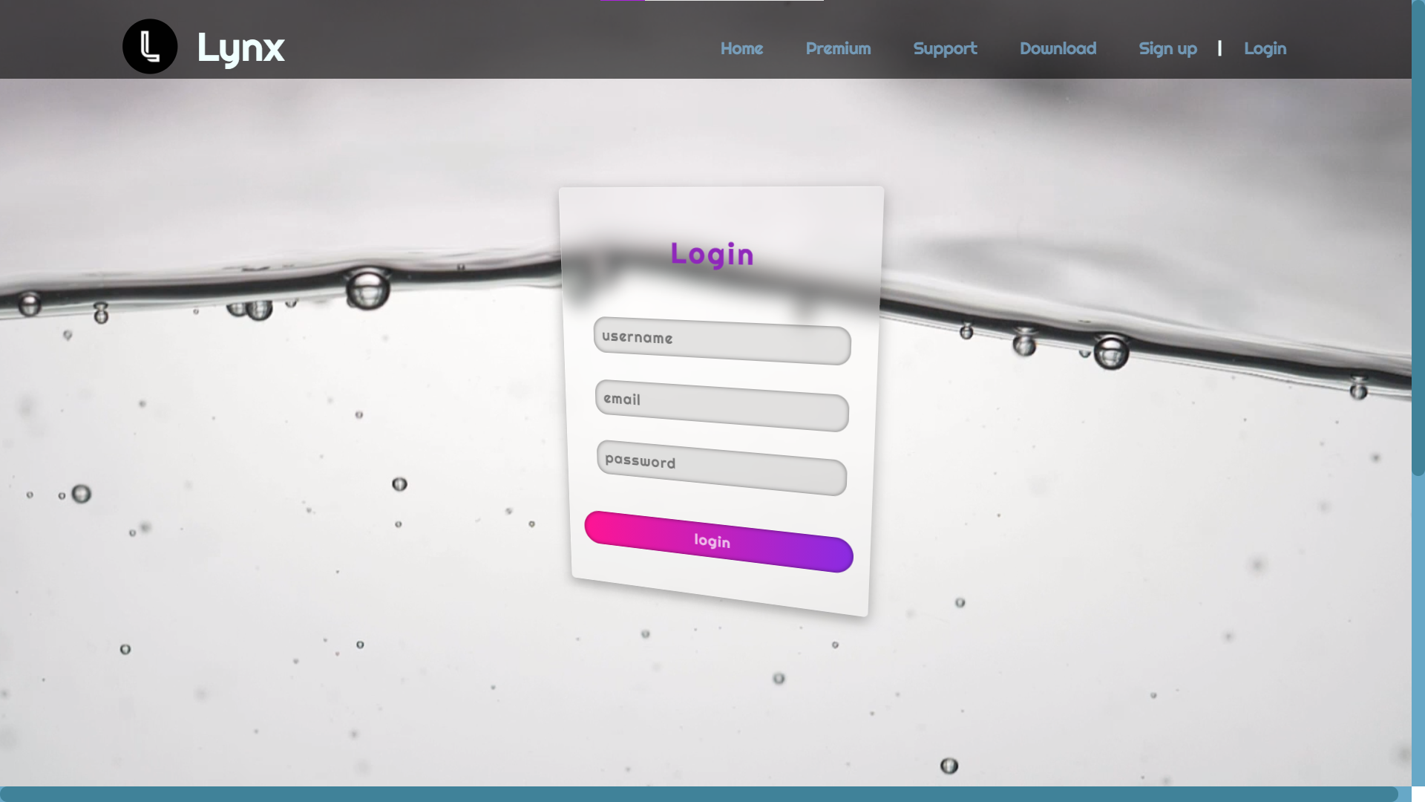
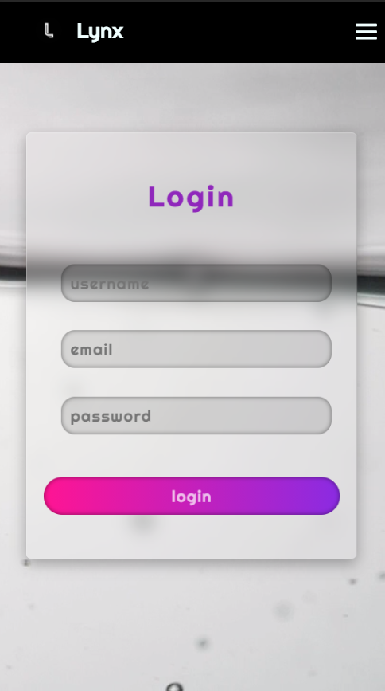
Login page light theme:

Slide 18
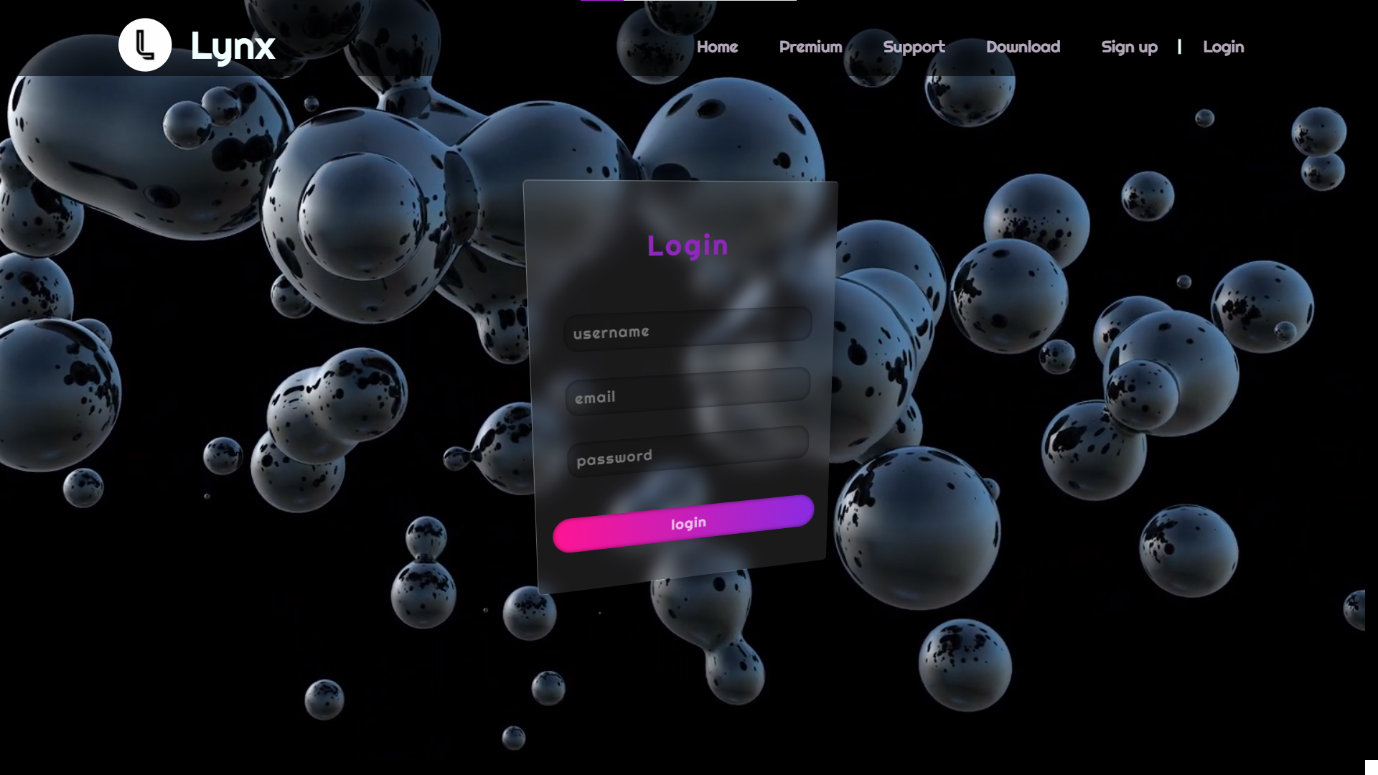
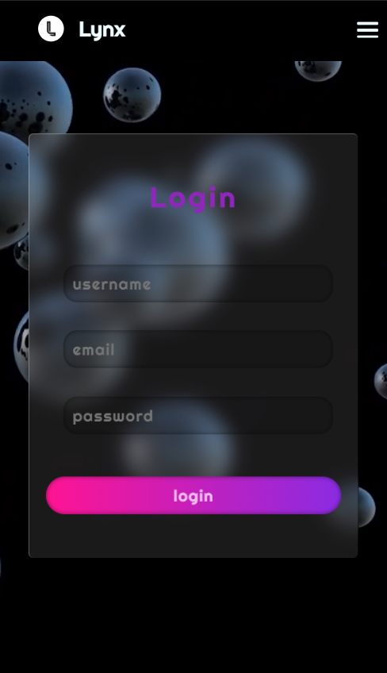
Login page dark theme:

Slide 19
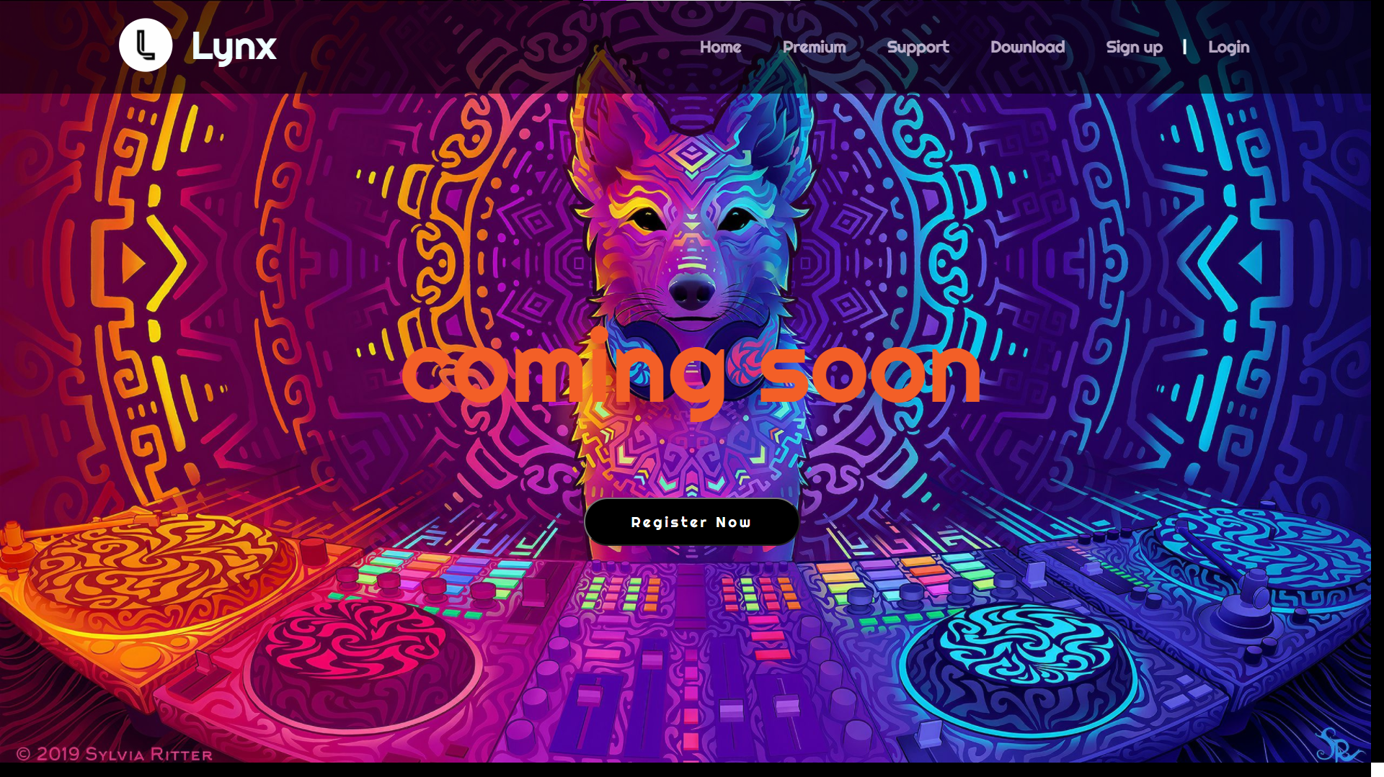
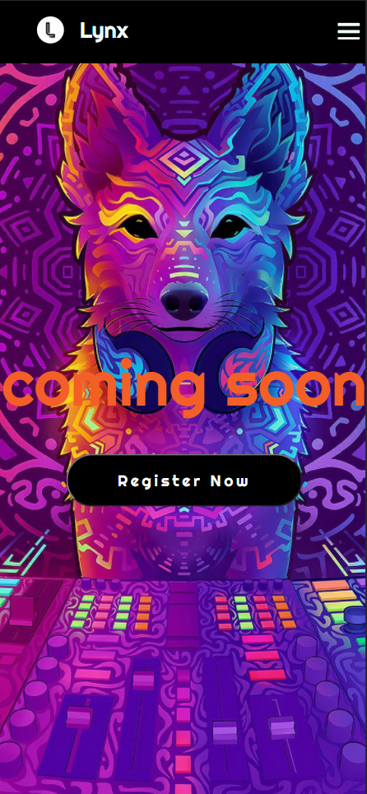
Premium page :

Slide 20
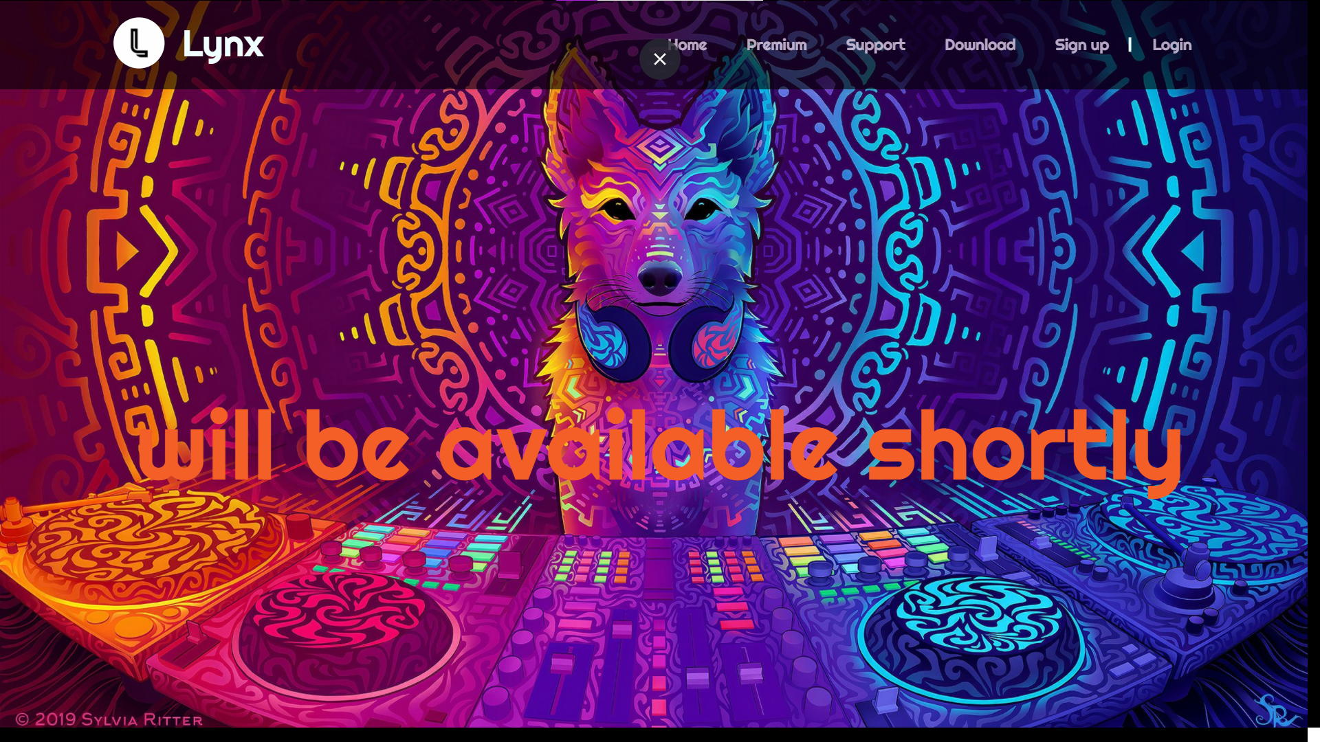
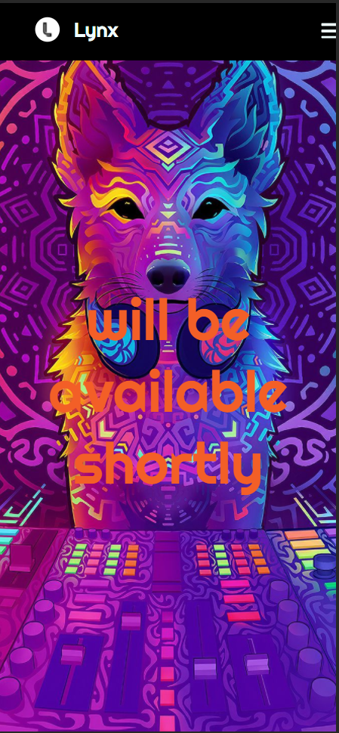
Support page :

Slide 21
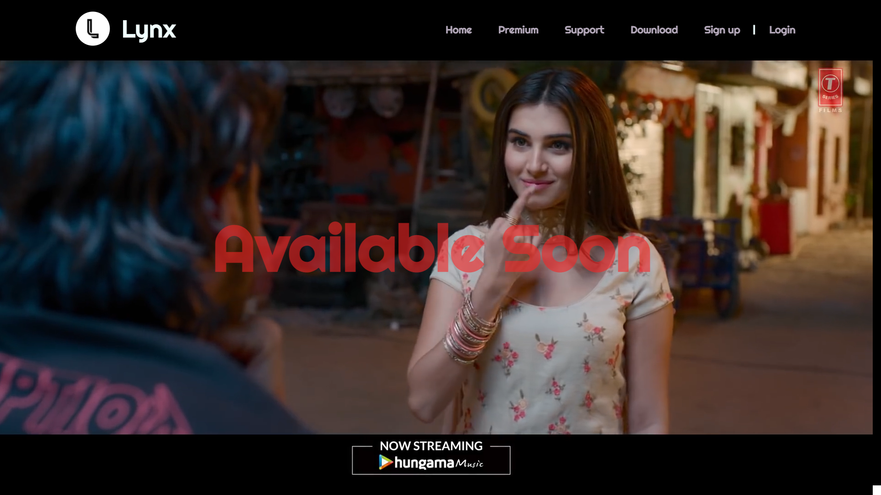
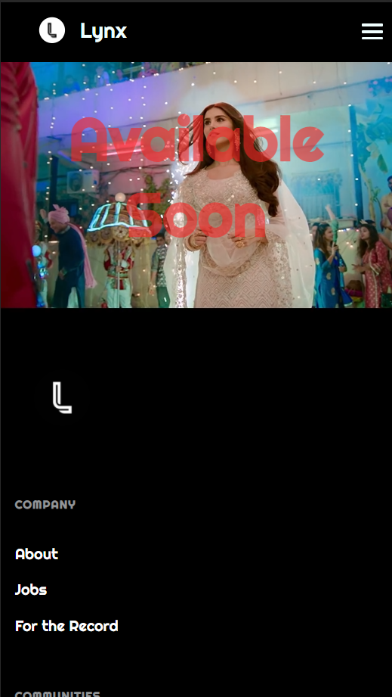
Download page :

Slide 22
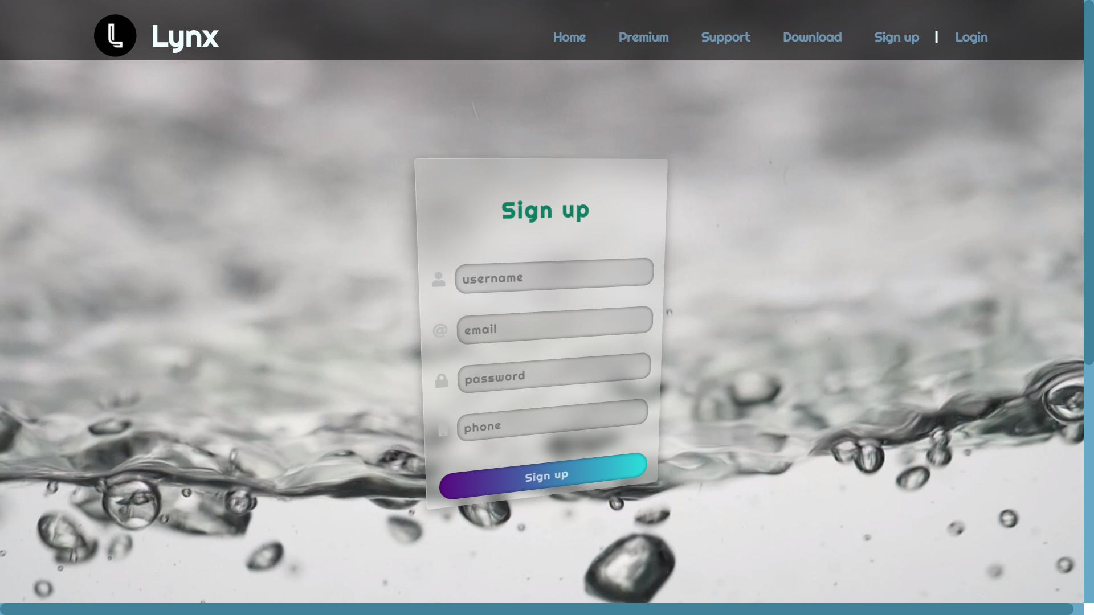
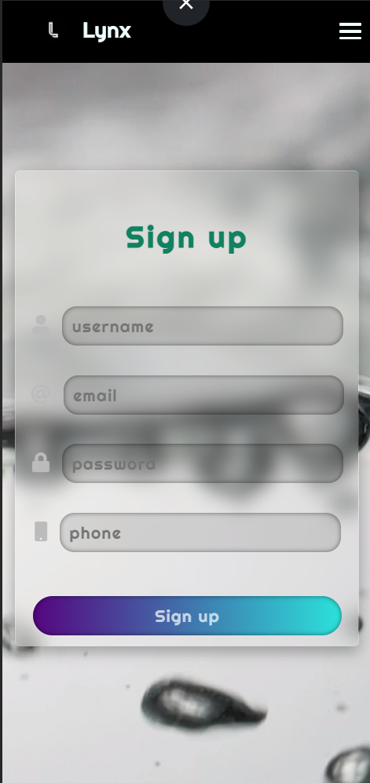
Signup page :

Slide 23
Thank You!

